Slide 1


Slide 2

A Transformer-Based Detector for Network Steganography with Improved Generalization
The University of Chakwal
Department of Computer Science & Information Technology
Malaika Umbreen UOC-IT-F2022-87
Shamama Muzaffar UOC-IT-F2022-69
Laraib Fatima UOC-IT-F2022-74
Supervisor : Mr. Fahim Abid

Slide 3
Team member name:
Malaika Umbreen: UOC-IT-F2022-87
Department of Computer Science & Information Technology, University of Chakwal

Slide 4
Contents
Introduction
Existing Systems & Research Gap
Problem Statement
Proposed Solution
Project Scope & Objectives
Functional Requirements
System Diagrams
Tools & Technologies
Model Evaluation Results
System Screenshots
Conclusion & Future Work
Department of Computer Science & Information Technology, University of Chakwal

Slide 5
Introduction
Network steganography hides secret data inside normal network protocol traffic (DNS, ICMP, TCP, UDP) unlike encryption, it conceals the very existence of the communication.
Adversaries use it for data exfiltration, covert Command & Control (C2), and long-term persistence inside compromised networks using freely available tools: dns2tcp, dnscat2, iodine, Ptunnel, Covert_TCP.
Conventional IDS (Snort, Zeek), firewalls, and deep packet inspection cannot detect protocol-compliant covert traffic- they generate no alert.
Existing deep learning detectors (LSTM, CNN) fail catastrophically on new techniques: LSTM dropped from 99.4% → 76.9% accuracy under cross-technique evaluation (Cho & Lai).
This project delivers a real-time, browser-accessible detection platform powered by a custom Transformer model no specialist training required to operate.
Department of Computer Science & Information Technology, University of Chakwal
Department of Computer Science & Information Technology, University of Chakwal

Slide 6
Existing Systems
Approach | Standard Accuracy | Cross-Technique (LOTO) | Key Failure
Signature-Based IDS (Snort/Zeek) | Known Tools only | N/A | Cannot detect new or modified tools
Statistical Methods | Moderate | Fails with evasion | Requires enviroment specific calibration
SVM | 85-92% | Not evaluated | Manual feature engineering ;protocol-specific
Random Forest | Moderate | Not evaluated | No temporal dependancy modelling
CNN | ~76-87% | 76.20% (collapse) | Local receptive field ; technique overfitting
LSTM (Cho & Lai 2021) | 99.4% | 76.9%(collapse) | Learns tool signatures, not behavior
LSTM dropped 22.5 percentage points under cross-technique evaluation; operationally catastrophic for a real SOC.No existing system provides: multi-protocol + behavioural generalisation + web interface + forensic interpretability- all in one.
Department of Computer Science & Information Technology, University of Chakwal

Slide 7
Problem Statement
5 core failure dimensions (no existing system solves all):
Signature-based systems: reactive only; any modified tool bypasses detection entirely
Classical ML : protocol-specific feature engineering; no cross-protocol transfer
Deep learning brittleness : collapses on unseen techniques (LSTM: 99.4% → 76.9%)
Anti-forensic evasion gap: no multi-protocol detector evaluated against timing obfuscation, header randomisation, and flow blending simultaneously
Formal Problem:
A real-world network steganography detector must simultaneously achieve high cross-technique generalisation, multi-protocol coverage, behavioral learning, anti-forensic robustness, and analyst-accessible forensic output. No existing published system delivers all five.
Department of Computer Science & Information Technology, University of Chakwal

Slide 8
Proposed Solution
Each of 225 flow-level behavioral features treated as an independent Transformer token.
Three simultaneous outputs: Binary Detection (Normal/Covert) + Technique (Header Manipulation / Timing Obfuscation / Flow Blending) + Protocol (DNS/ICMP/TCP/UDP).
Trained on 13,848 samples; all identifiers (IPs, ports, timestamps) removed before training to enforce Behavioral generalization.
Live capture controls, real-time alerts panel, technique doughnut chart, protocol bar graph.
Flow detail, technique analysis, protocol statistics, CSV log export.
Accessible from any modern browser no command-line access needed.
Department of Computer Science & Information Technology, University of Chakwal

Slide 9
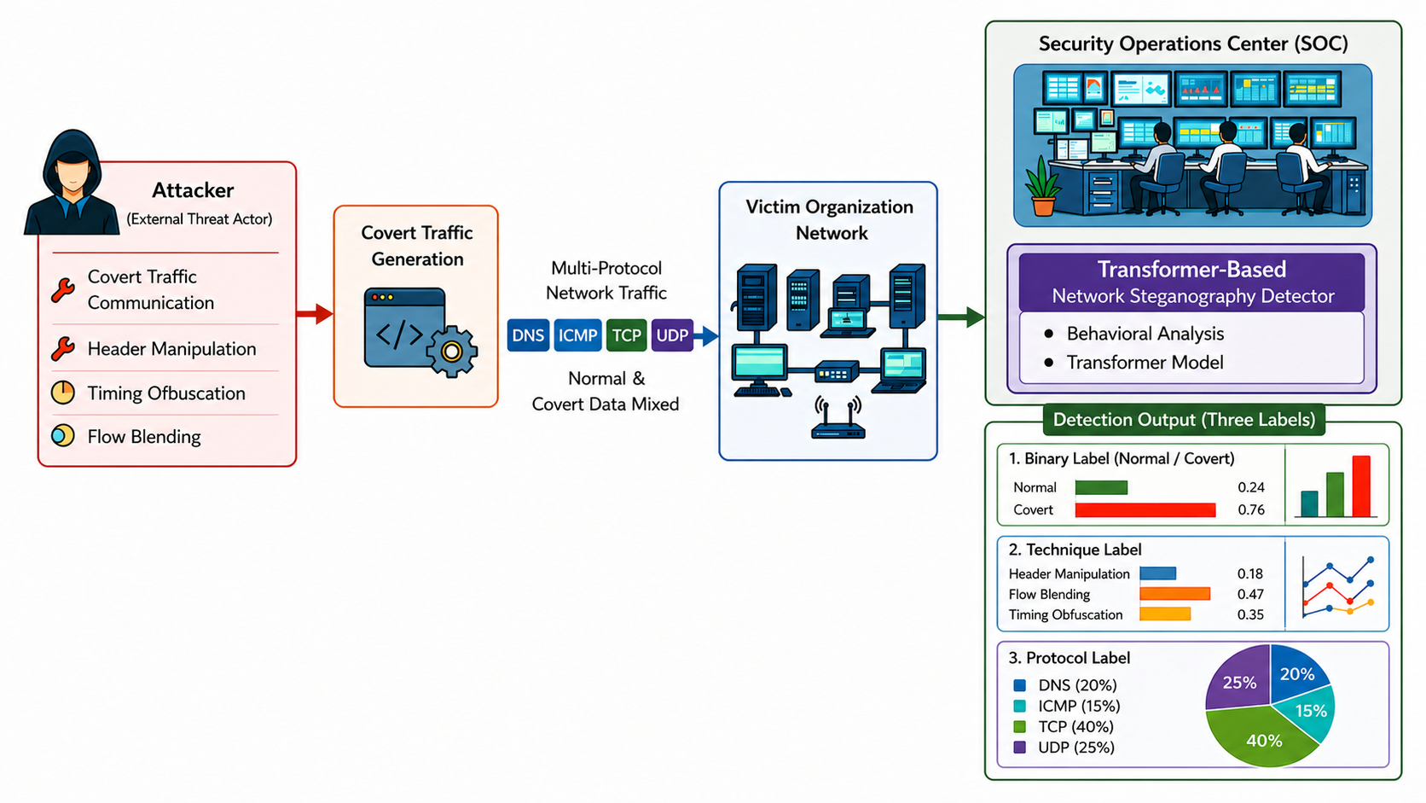
Proposed Solution
Department of Computer Science & Information Technology, University of Chakwal

Slide 10
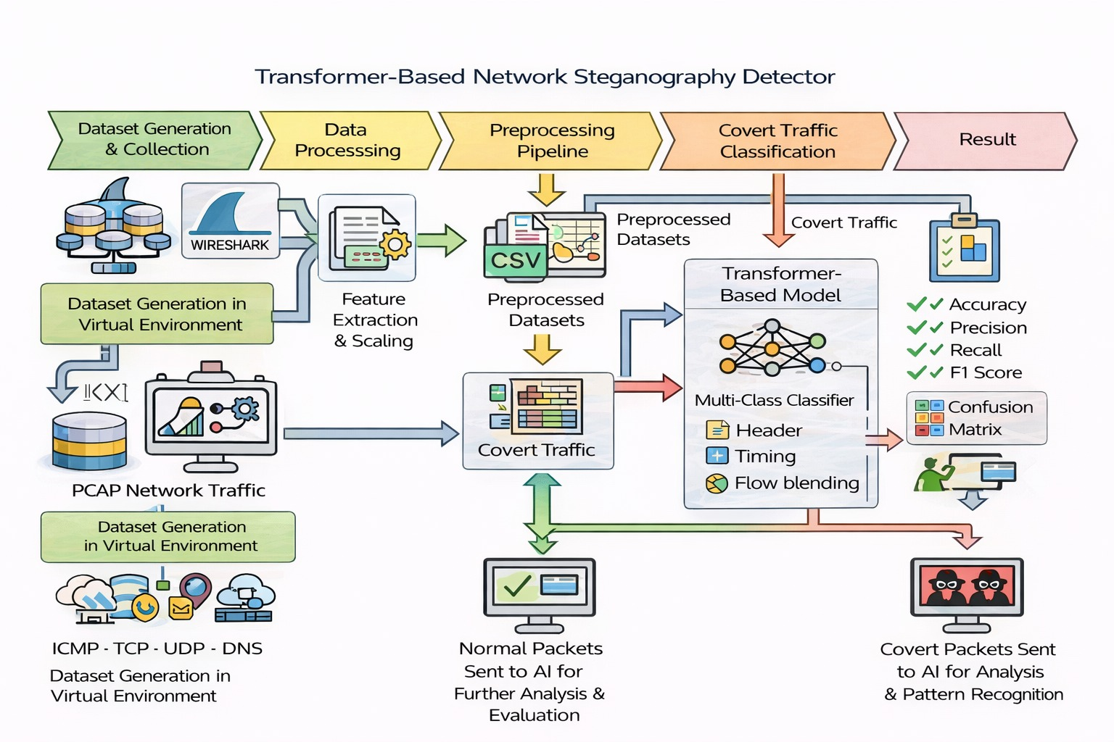
Diagrams – End –to-End pipeline of Transformer based detector for an Network Steganography
Department of Computer Science & Information Technology, University of Chakwal

Slide 11
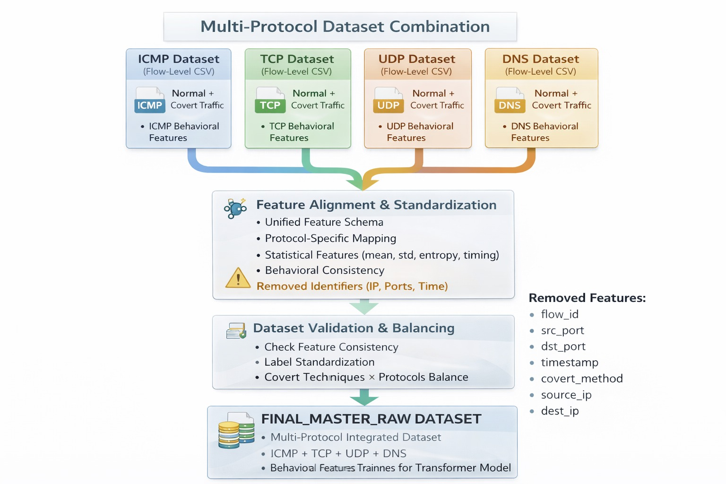
Diagrams – Multi protocol Dataset combination
Department of Computer Science & Information Technology, University of Chakwal

Slide 12
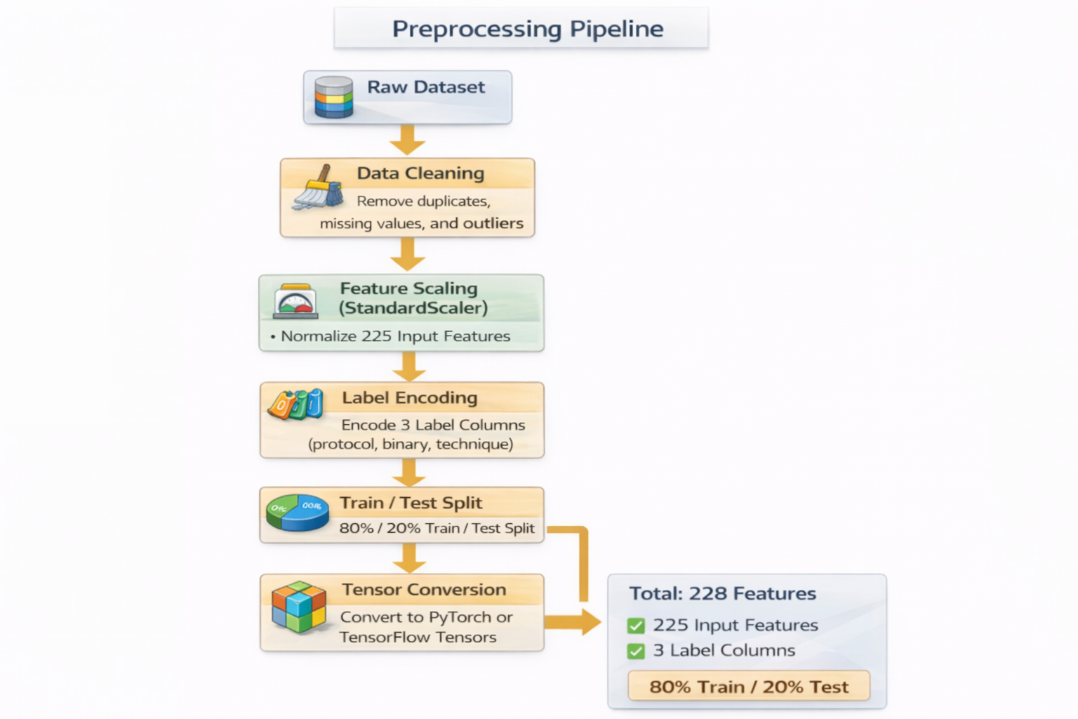
Diagrams – Preprocessing
Department of Computer Science & Information Technology, University of Chakwal

Slide 13
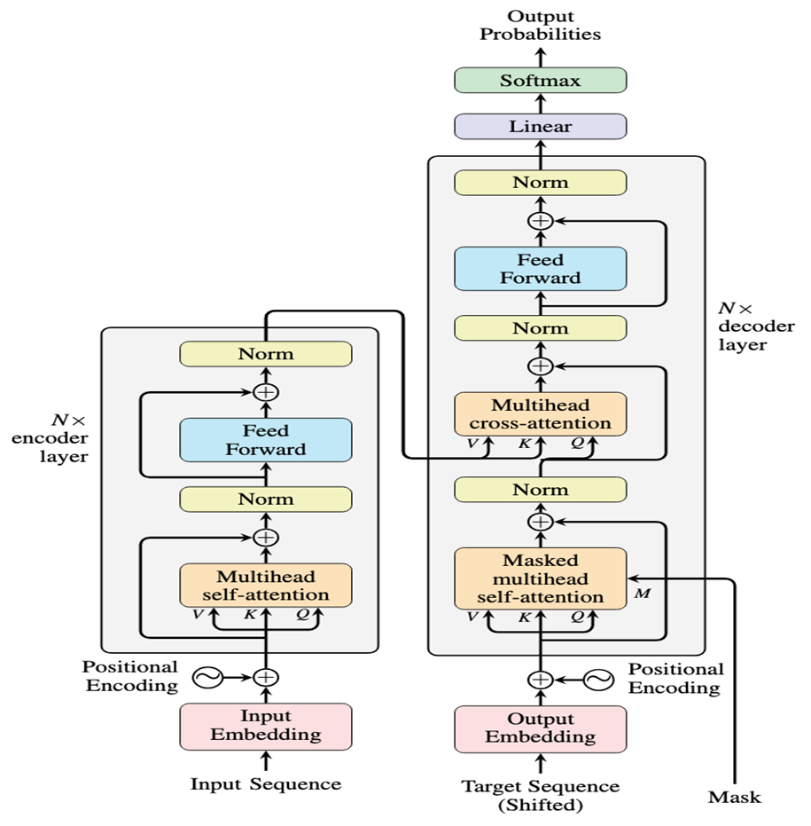

Slide 14
Next team member:
Shamama Muzaffar : UOC-IT-F2022-69
Department of Computer Science & Information Technology, University of Chakwal

Slide 15
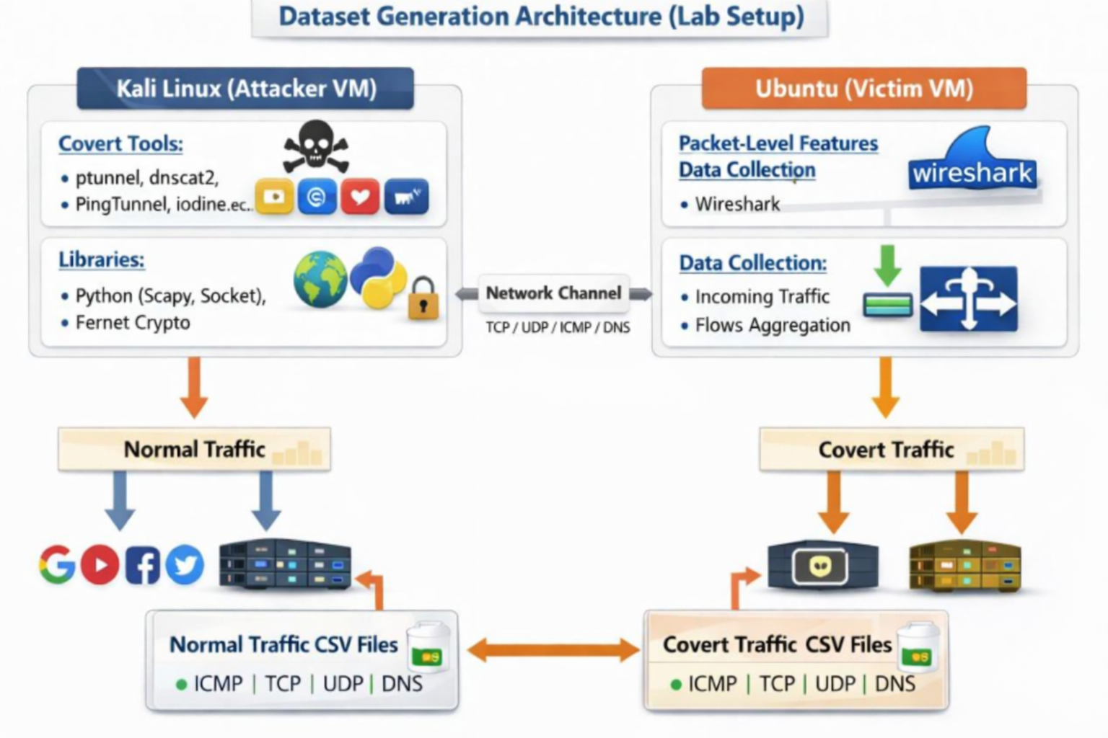
Diagrams – Dataset Generation
Department of Computer Science & Information Technology, University of Chakwal

Slide 16
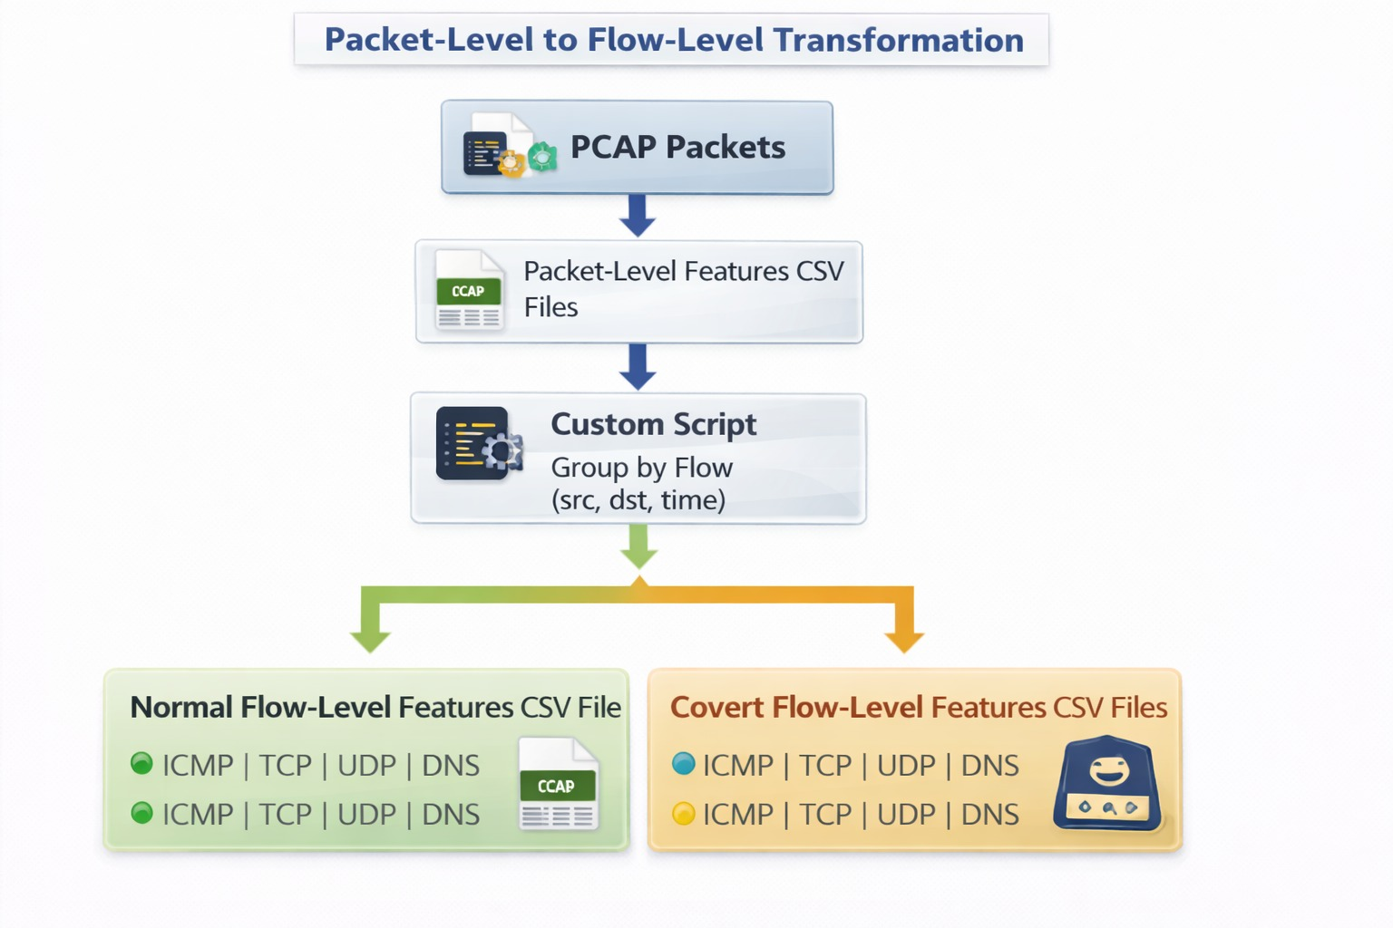
Diagrams - Packet to flow level features conversion
Department of Computer Science & Information Technology, University of Chakwal

Slide 17
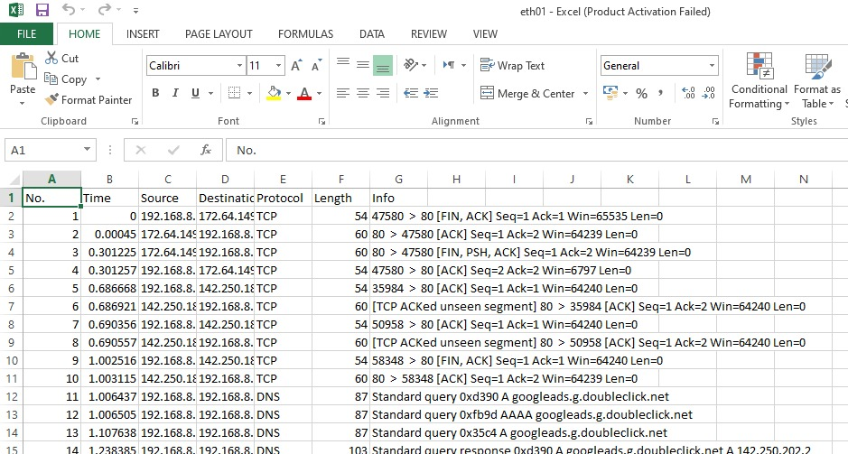

Slide 18
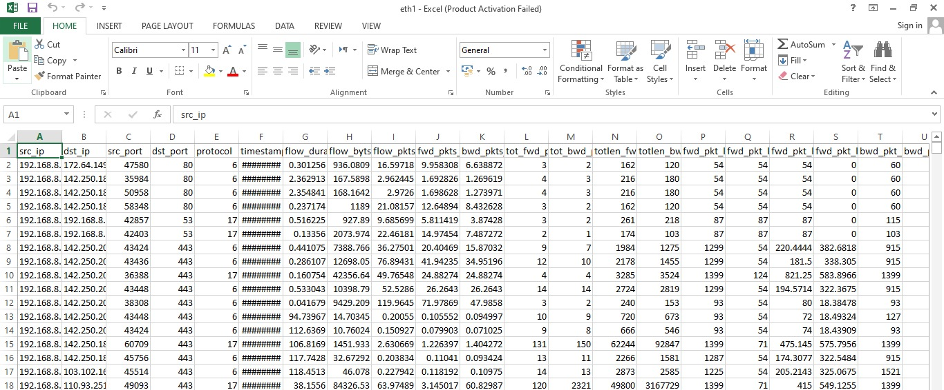

Slide 19
Project Scope
IN SCOPE:
Detection across DNS, ICMP, TCP, UDP using 225 flow-level behavioral features
React.js + TypeScript frontend with live Npcap capture
FAST API + MySQL database backend
Pre-trained FeatureTokenTransformer via Python Flask microservice
Windows 10/11; Chrome, Firefox, Edge compatible
CSV audit log export
OUT OF SCOPE:
Physical-layer / side-channel steganography
Application-layer media steganography (image, audio, video)
Linux / macOS deployment (Npcap is Windows-only)
Department of Computer Science & Information Technology, University of Chakwal

Slide 20
Functional Requirements
# | Module | Function
FR-1 | User Authentication | Registration, login, session enforcement, secure logout
FR-2 | Traffic Capture | Start/Stop Npcap from dashboard; live packet display with IP, protocol, timestamp
FR-3 | Dashboard Analytics | Live alerts panel, technique doughnut chart, protocol bar graph, recent detections table
FR-4 | Flow Detail Analysis | Per-protocol Normal vs. Covert % breakdown, tabbed navigation
FR-5 | Technique Analysis | Bar (Normal/Covert), pie (Flow Blending), line (Timing Obfuscation) charts per protocol
FR-6 | Protocol Analysis | Packet count, covert detection count, real-time traffic graph (≤5s update interval)
FR-7 | Logs & Export | Persistent MySQL detection logs + CSV export for audit
Total: 22 Functional Requirements + 20 Non-Functional Requirements all verified and passed.
Department of Computer Science & Information Technology, University of Chakwal

Slide 21
Project Objectives
Detection Model Objectives:
Integrate FeatureTokenTransformer achieving ≥ 90% binary accuracy across all 4 protocols Achieved: 94.42%
Validate technique classification and protocol attribution
Analyzes it on unseen data to perform generalization (LOTO)
Web Application Objectives:
Live Npcap capture via Start/Stop dashboard controls
Real-time dashboard with alerts, charts, tables
Flow Detail, Technique Analysis, Protocol Analysis, Detection Logs modules
CSV export for offline reporting
Department of Computer Science & Information Technology, University of Chakwal

Slide 22
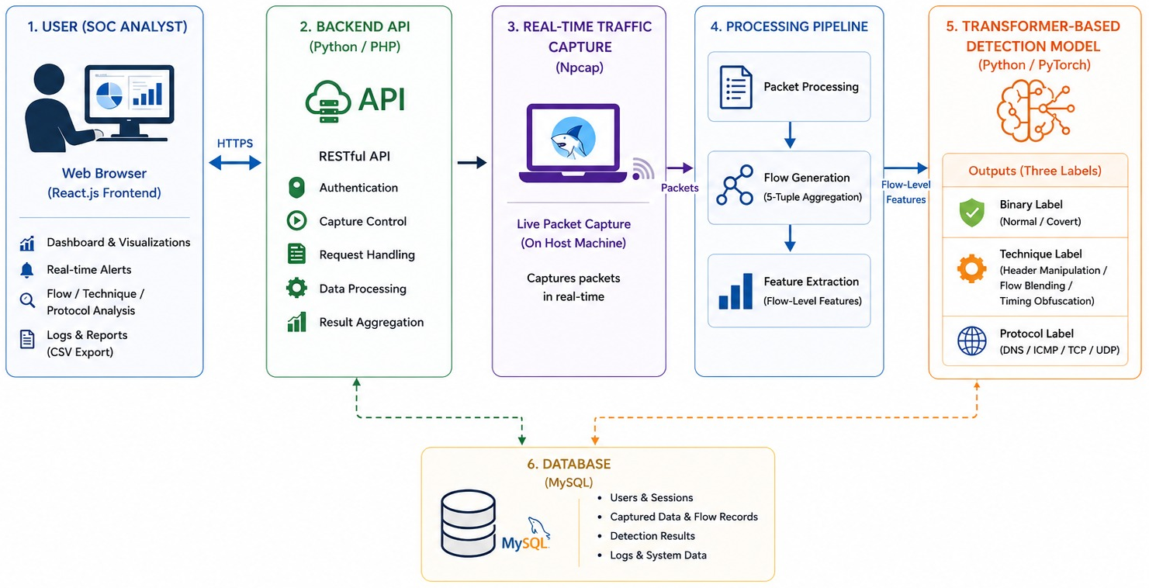
Diagrams –Architecture Design Diagram(StegFix)
Department of Computer Science & Information Technology, University of Chakwal

Slide 23
Tools & Technologies
Layer | Technology
Frontend | React.js , TSX(Typescript), CSS3, Chart.js,
Backend | MySQL 8.0, Python , JSON
Packet Capture | Npcap 1.78, Wireshark 4.0.6
ML / Interface | Python 3.9, PyTorch 2.0 , Python Flask 2.3
Development Enviroment | VS Code, GitHub, Node.js 18+
OS Requirement | Windows 10/11 64-bit (Npcap requirement)
Training Hardware | Intel Core i7, 16 GB RAM, NVIDIA GPU
Department of Computer Science & Information Technology, University of Chakwal

Slide 24
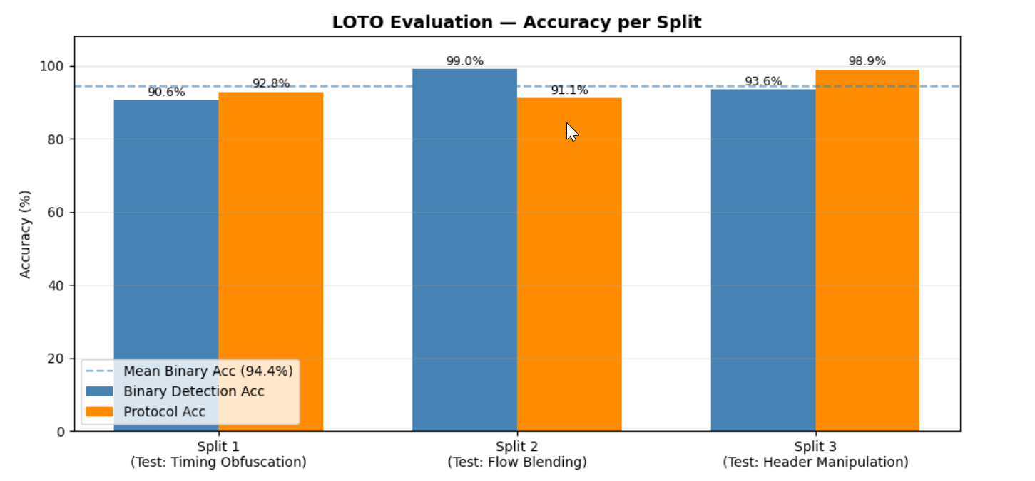

Slide 25
Next team member:
Laraib Fatima : UOC-IT-F2022-74
Department of Computer Science & Information Technology, University of Chakwal

Slide 26
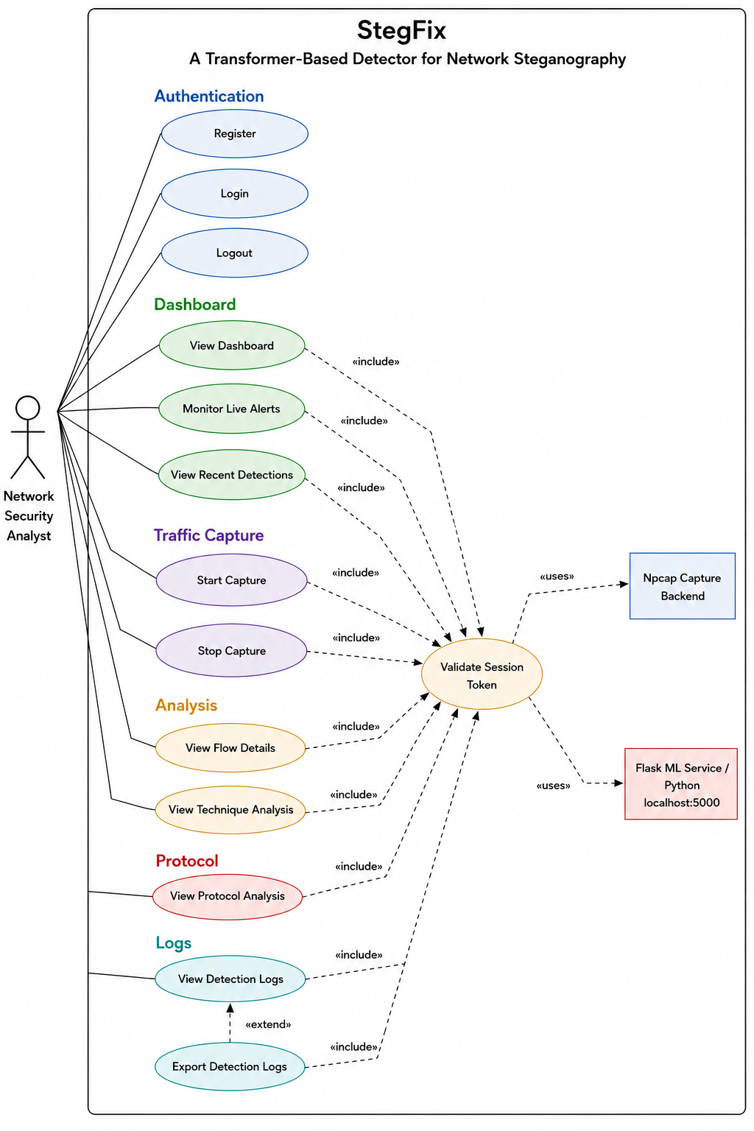
Diagrams - Use Case Diagram
Department of Computer Science & Information Technology, University of Chakwal

Slide 27
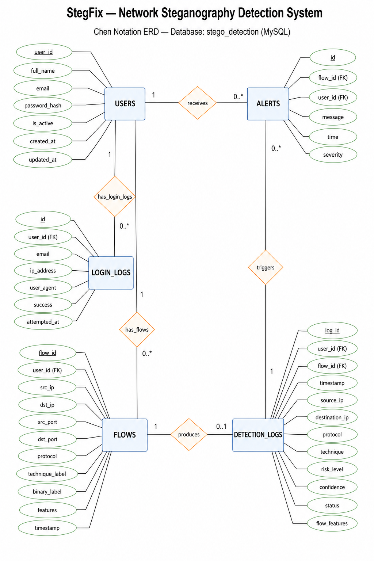
Diagrams -ERD
Department of Computer Science & Information Technology, University of Chakwal

Slide 28
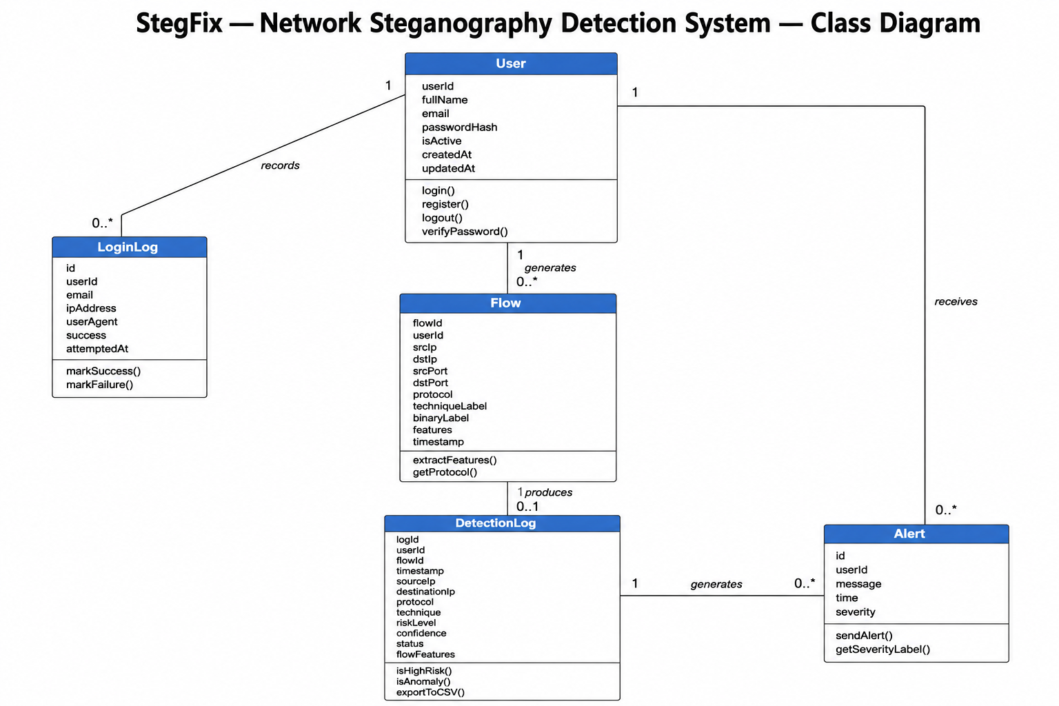
Diagrams –Class Diagram
Department of Computer Science & Information Technology, University of Chakwal

Slide 29
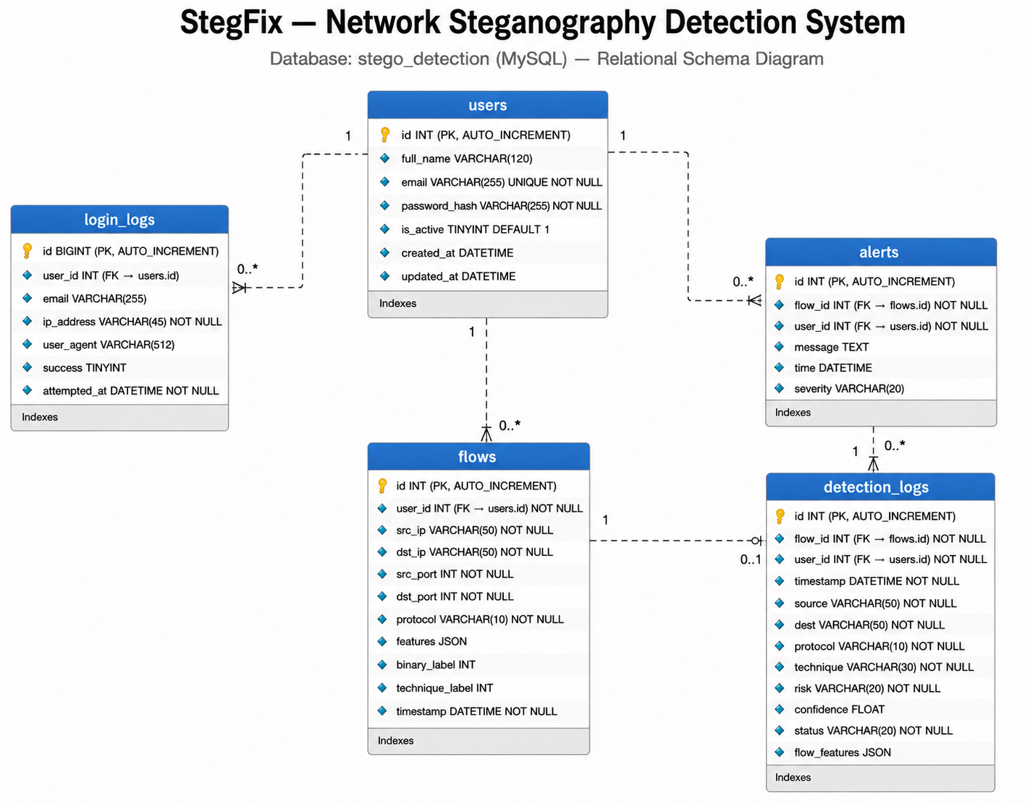
Diagrams –Database Design
Department of Computer Science & Information Technology, University of Chakwal

Slide 30
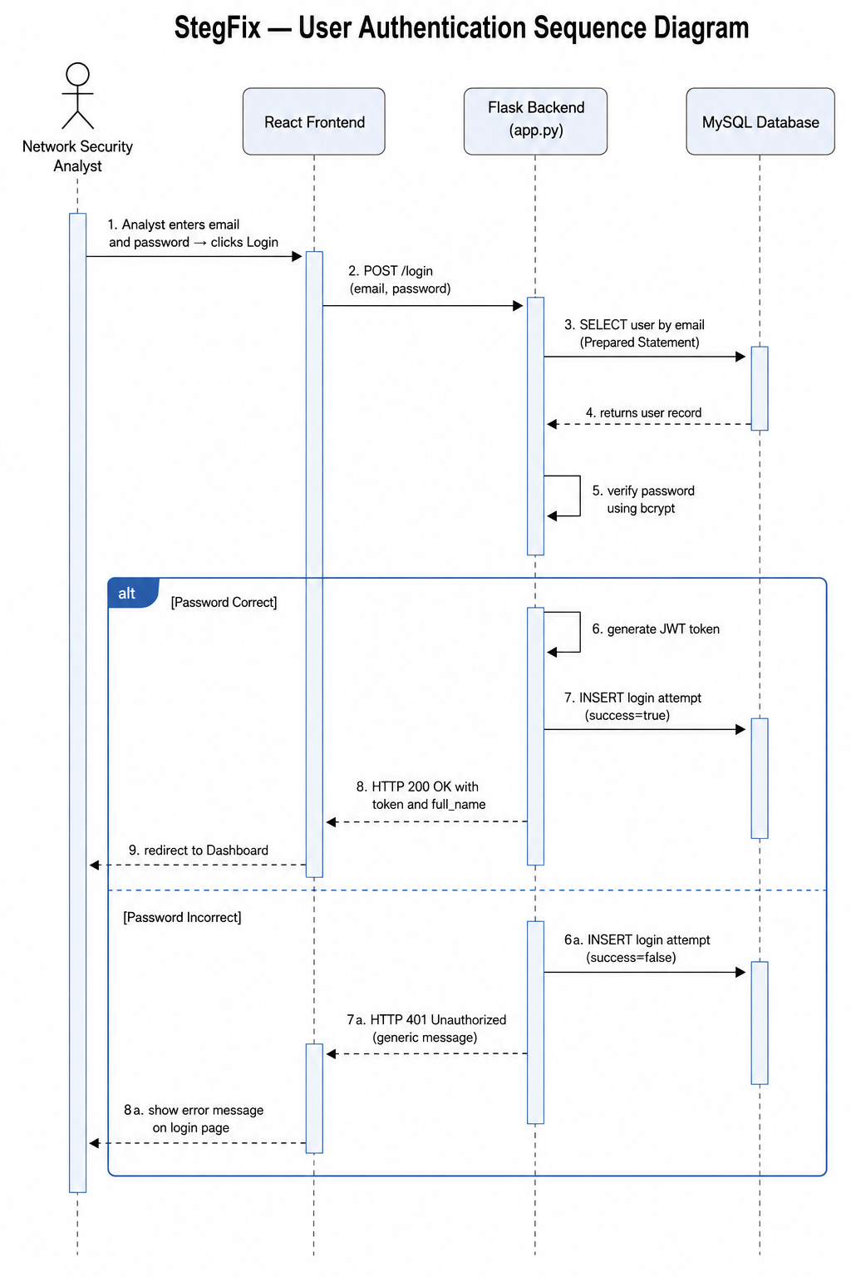
Diagrams –Sequence Diagram
Sequence Diagram : User Authentication
Department of Computer Science & Information Technology, University of Chakwal

Slide 31
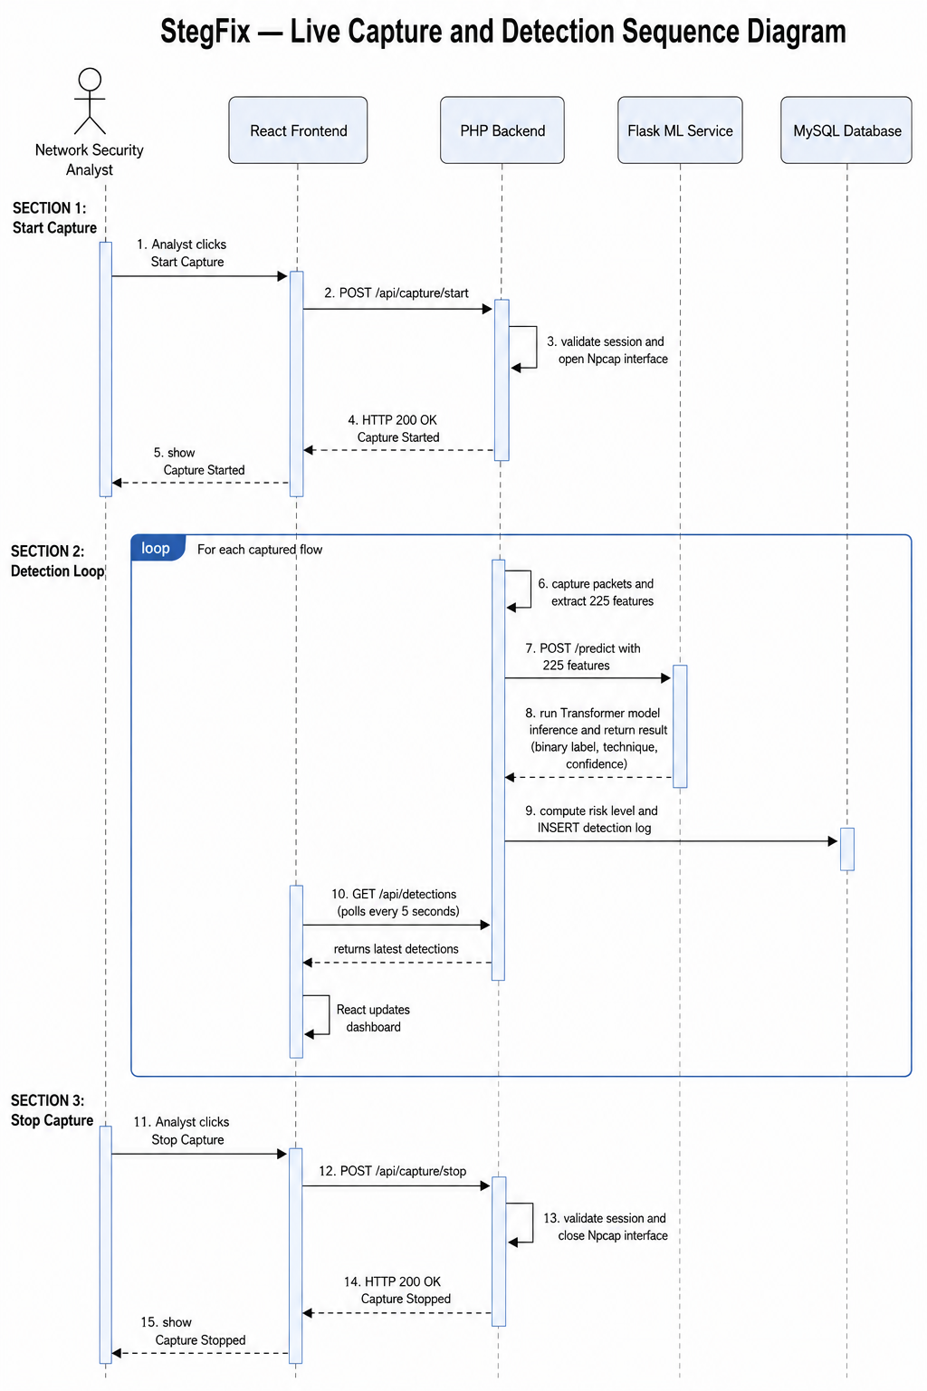
Diagrams –Sequence Diagram
Sequence Diagram : Live Capture and Detection Flow
Department of Computer Science & Information Technology, University of Chakwal

Slide 32
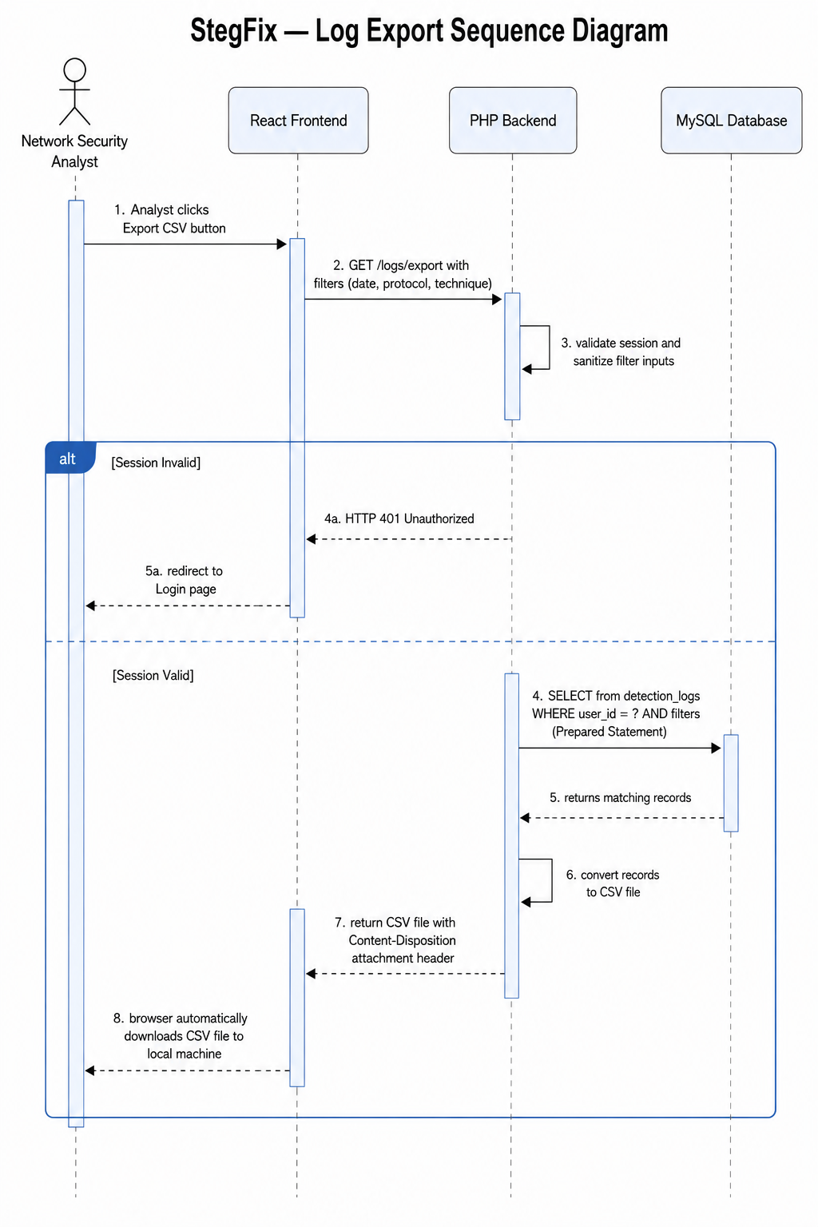
Diagrams –Sequence Diagram
Sequence Diagram: CSV Log Export Flow
Department of Computer Science & Information Technology, University of Chakwal

Slide 33
Conclusion & Future Work
Conclusion:
Behavioral generalization : Removing all traffic identifiers before training ensures the model learns behavior, not tool fingerprints. Minimum accuracy floor: 90.60% even on completely unseen techniques.
Five-dimensional gap closed: High generalization accuracy + behavioral learning + forensic interpretability + browser-accessible analyst interface; all achieved simultaneously.
Future Research Directions
1. Real-world traffic validation: authenticate framework performance on live, uncontrolled network environments
2. Protocol expansion: extend support to QUIC, HTTP/2, DNS-over-HTTPS, and IPv6 extension headers
3. Connect with security tools: plug into Splunk, Zeek, and Wireshark for seamless SOC workflow adoption
4. Federated Learning: train model across organizations to improve generalization without exposing raw traffic data.
Department of Computer Science & Information Technology, University of Chakwal

Slide 34
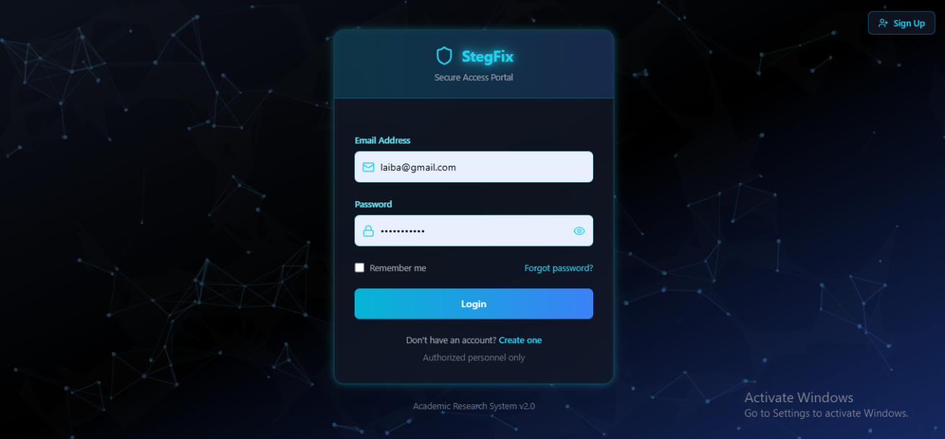
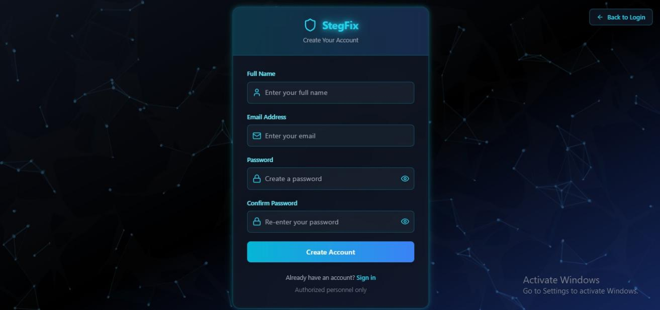
App - Screenshots
Department of Computer Science & Information Technology, University of Chakwal

Slide 35
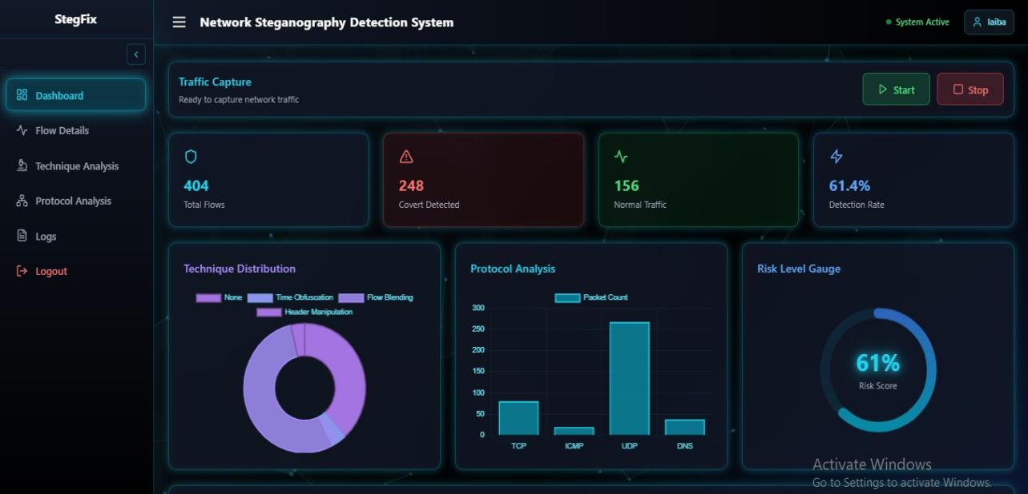
Screenshots
Department of Computer Science & Information Technology, University of Chakwal

Slide 36
Screenshots
Department of Computer Science & Information Technology, University of Chakwal

Slide 37
Screenshots
Department of Computer Science & Information Technology, University of Chakwal

Slide 38
Screenshots
Department of Computer Science & Information Technology, University of Chakwal

Slide 39
Screenshots
Department of Computer Science & Information Technology, University of Chakwal

Slide 40
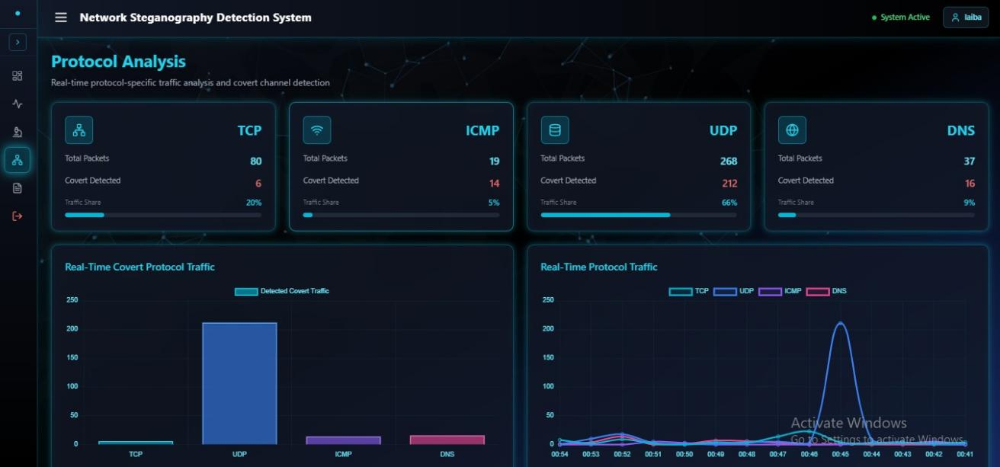
Screenshots
Department of Computer Science & Information Technology, University of Chakwal

Slide 41
Screenshots
Department of Computer Science & Information Technology, University of Chakwal

Slide 42
Tasks Distribution
Group Members | Responsibilities
Malaika Umbreen | Dataset combining (Kaggle DNS + self-generated ICMP, TCP, UDP data) Data preprocessing and final dataset preparation FeatureTokenTransformer model training LOTO (Leave-One-Technique-Out) evaluation and results analysis All model-related work and inference microservice integration
Shamama Muzaffar | Self-generated dataset creation (ICMP, TCP, UDP covert and normal traffic in lab environment) Complete React.js frontend development and dashboard UI PHP RESTful API backend development MySQL database design and implementation Real-time functionality (live capture, alerts, charts, CSV export)
Laraib Fatima | Features extraction , Features categorization in an Dataset (Time obfuscation ,Flow blending, Header Manipulation) All references and literature review documentation Figures, diagrams and images preparation (Use Case, ERD, Class Diagram, Architecture, Sequence Diagrams, Interface Designs) Complete project documentation and FYP Book writing
Department of Computer Science & Information Technology, University of Chakwal

Slide 43
REFERENCES:
[1] G. J. Simmons, “The prisoners’ problem and the subliminal channel,” in Advances in Cryptology: Proc. CRYPTO 83, D. Chaum, Ed. New York, NY: Plenum Press, 1984, pp. 51–67. [Online]. Available: https://link.springer.com/chapter/10.1007/978-1-4684-4730-9_5
[2] B. W. Lampson, “A note on the confinement problem,” Communications of the ACM, vol. 16, no. 10, pp. 613–615, Oct. 1973. [Online]. Available: https://doi.org/10.1145/362375.362389
[3] S. Wendzel, S. Zander, B. Fechner, and C. Herdin, “Pattern-based survey and categorization of network covert channel techniques,” ACM Computing Surveys, vol. 47, no. 3, Art. no. 50, Feb. 2015. [Online]. Available: https://doi.org/10.1145/2684195
[4] W. Mazurczyk, S. Wendzel, S. Zander, A. Houmansadr, and K. Szczypiorski, Information Hiding in Communication Networks: Fundamentals, Mechanisms, Applications, and Countermeasures. Hoboken, NJ: Wiley-IEEE Press, 2016. ISBN: 978-1-118-86169-1. [Online]. Available: https://www.wiley.com/en-us/Information+Hiding+in+Communication+Networks-p-9781118861691
[5] S. Wendzel, W. Mazurczyk, L. Caviglione, and A. Mileva, “Hiding patterns in network steganography: A reference model and survey,” IEEE Communications Surveys & Tutorials, vol. 21, no. 2, pp. 1441–1476, 2nd Qtr. 2019. [Online]. Available: https://doi.org/10.1109/COMST.2019.2906838
[6] S. Zander, T. Nguyen, and G. Armitage, “Automated traffic classification and application identification using machine learning,” in Proc. IEEE Conference on Local Computer Networks (LCN), Sydney, NSW, Australia, 2005, pp. 250–257. [Online]. Available: https://doi.org/10.1109/LCN.2005.35
[7] S. Zander, G. Armitage, and P. Branch, “A survey of covert channels and countermeasures in computer network protocols,” IEEE Communications Surveys and Tutorials, vol. 9, no. 3, pp. 44–57, 3rd Qtr. 2007. [Online]. Available: https://doi.org/10.1109/COMST.2007.4317620
Department of Computer Science & Information Technology, University of Chakwal

Slide 44
REFERENCES:
8] E. Revyakina and A. Gazizov, “Development of methods and tools for implementing and detecting network steganography,” Bulletin of Don State Technical University, vol. 21, no. 1, pp. 88–96, 2021. [Online]. Available: https://doi.org/10.23947/2687-1653-2021-21-1-88-96
[9] K. Cho and C.-H. Lai, “A new approach for network steganography detection based on deep learning techniques,” International Journal of Advanced Computer Science and Applications (IJACSA), vol. 12, no. 7, 2021. [Online]. Available: http://dx.doi.org/10.14569/IJACSA.2021.0120705
[10] M. W. U. Rahman, Y.-Z. Lin, C. Weeks, D. Ruddell, J. Gabriellini, B. Hayes, S. Hariri, P. Satam, and E. V. Ziegler Jr., “AI/ML based detection and categorization of covert communication in IPv6 network,” IEEE Access, vol. 10, pp. 98898–98912, 2022. [Online]. Available: https://doi.org/10.1109/ACCESS.2022.3206291
[11] S. Hochreiter and J. Schmidhuber, “Long short-term memory,” Neural Computation, vol. 9, no. 8, pp. 1735–1780, Nov. 1997. [Online]. Available: https://doi.org/10.1162/neco.1997.9.8.1735
[12] Y. LeCun, L. Bottou, Y. Bengio, and P. Haffner, “Gradient-based learning applied to document recognition,” Proceedings of the IEEE, vol. 86, no. 11, pp. 2278–2324, Nov. 1998. [Online]. Available: https://doi.org/10.1109/5.726791
[13] A. Vaswani, N. Shazeer, N. Parmar, J. Uszkoreit, L. Jones, A. N. Gomez, Ł. Kaiser, and I. Polosukhin, “Attention is all you need,” in Advances in Neural Information Processing Systems (NeurIPS), vol. 30, 2017. [Online]. Available: https://arxiv.org/abs/1706.03762
[14] J. Devlin, M.-W. Chang, K. Lee, and K. Toutanova, “BERT: Pre-training of deep bidirectional Transformers for language understanding,” in Proc. NAACL-HLT 2019, Minneapolis, MN, pp. 4171–4186, 2019. [Online]. Available: https://arxiv.org/abs/1810.04805
Department of Computer Science & Information Technology, University of Chakwal

Slide 45
REFERENCES:
[15] Q. Sun, J. Liu, J. Wang, T. Yan, D. An, and F. Qi, “Transformer-based detection method for DNS covert channel,” in Proc. International Symposium on Grids & Clouds (ISGC) & HEPiX Spring 2023 Workshop, PoS(ISGC & HEPiX2023), Article 011, 2023. [Online]. Available: https://doi.org/10.22323/1.434.0011
[16] R. Gurunath, A. H. Alahmadi, D. Samanta, M. Z. Khan, and A. Alahmadi, “A novel approach for linguistic steganography evaluation based on artificial neural networks,” IEEE Access, vol. 9, pp. 120869–120879, 2021. [Online]. Available: https://doi.org/10.1109/ACCESS.2021.3108183
[17] D. Polisetty and S. W. A. Rizvi, “GAN-based adaptive image steganography system for enhanced security and imperceptibility,” International Journal of Computer Applications, vol. 187, no. 6, pp. 12–19, May 2025. [Online]. Available: https://ijca.phdfocus.com/archives/volume187/issue6/gan-based-adaptive-image-steganography/
[18] S. Rahman, M. Merabti, and R. Askwith, “A novel and efficient digital image steganography technique using least significant bit substitution,” Scientific Reports, vol. 15, Art. no. 1455, 2025. [Online]. Available: https://doi.org/10.1038/s41598-024-83147-3
[19] Y. Feng, L. Xu, X. Lu, G. Zhang, and W. Rao, “A robust coverless audio steganography based on differential privacy clustering,” IEEE Transactions on Multimedia, pp. 1–16, 2025. [Online]. Available: https://doi.org/10.1109/TMM.2025.3543107
[20] N. A. Ali and R. J. Mstafa, “Optimizing region of interest selection for effective embedding in video steganography based on genetic algorithms,” Computer Systems Science and Engineering, vol. 47, no. 2, pp. 1451–1469, 2023. [Online]. Available: https://doi.org/10.32604/csse.2023.039957
[21] D. P. Kingma and J. Ba, “Adam: A method for stochastic optimization,” in Proc. International Conference on Learning Representations (ICLR), San Diego, CA, 2015. [Online]. Available: https://arxiv.org/abs/1412.6980
[22] A. Paszke et al., “PyTorch: An imperative style, high-performance deep learning library,” in Advances in Neural Information Processing Systems, vol. 32, pp. 8024–8035, 2019. [Online]. Available: https://arxiv.org/abs/1912.01703
[23] F. Pedregosa et al., “Scikit-learn: Machine learning in Python,” Journal of Machine Learning Research, vol. 12, pp. 2825–2830, 2011. [Online]. Available: https://jmlr.org/papers/v12/pedregosa11a.html
Department of Computer Science & Information Technology, University of Chakwal

Slide 46


